Slide 1
Twitter Real-Time Sentiment Analysis Progress Report
Tiancheng Shi, Yuanchen Wei

Slide 2
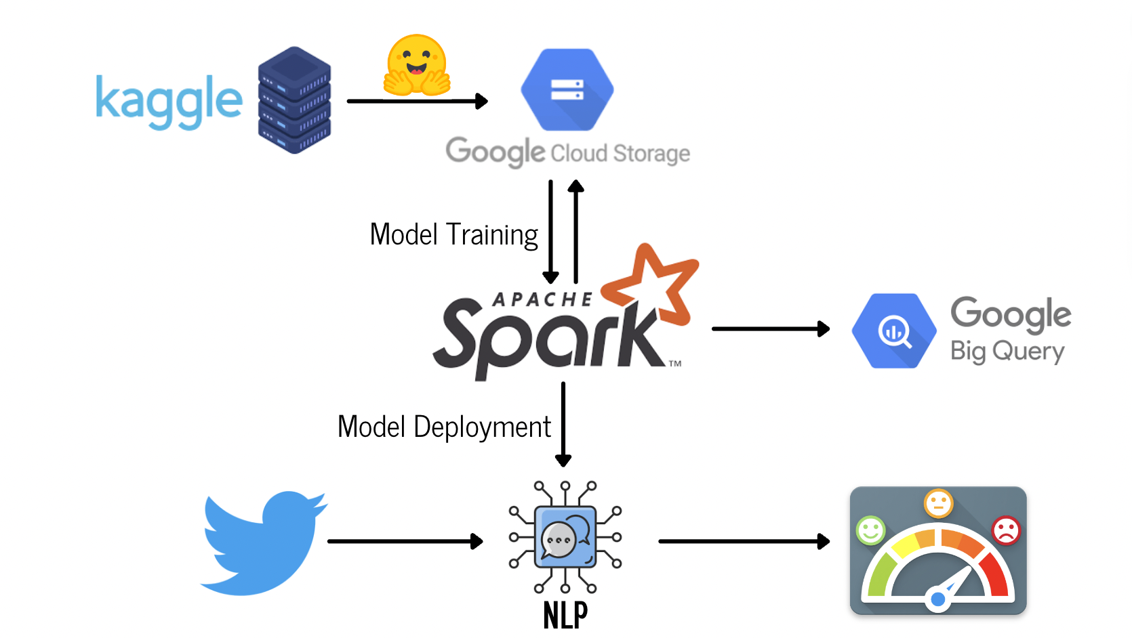
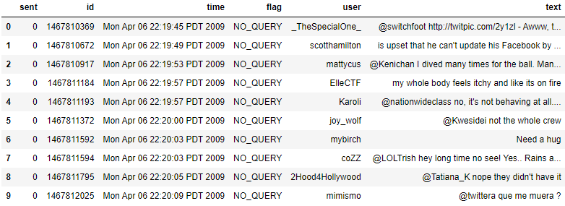
Overview
Collected the following static dataset from Kaggle
Performed data cleaning and exploratory analysis
Trained a base NLP model with text and sentiment

Slide 3
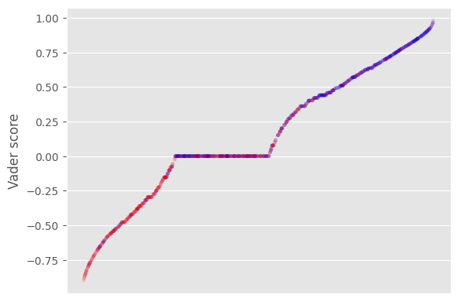
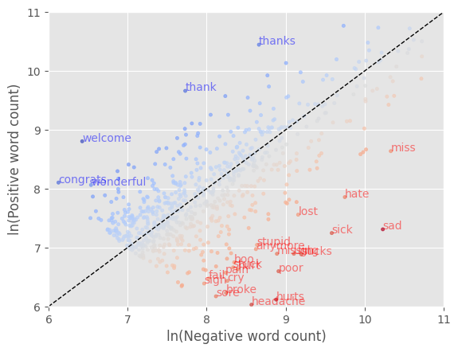
Methods
Applied NLTK word tokenizer and analyzed the word frequency patterns in different sentiments.
Applied Vader Sentiment Analyzer to generate a raw sentiment score between -1 (negative) and 1 (positive).
A data point deviated from the diagonal implies the intense sentiment of the word.

Slide 4
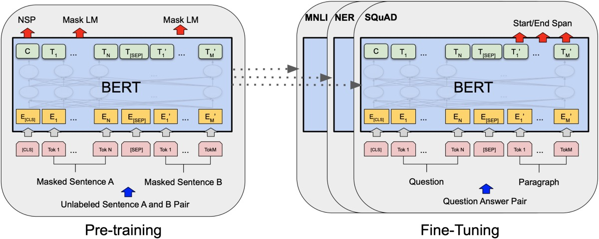
Methods (cont.)
Loaded pre-trained model from HuggingFace
BERT-base-uncased with 100M parameters
Dense Neural Network layers for text classification
Fine-tuned in 5 epochs
Validation accuracy: 80.57%

Slide 5
Evaluation
Evaluation on the labeled data
F1-Score
AUROC
Precision-Recall Curve
Robustness tests: manipulate the text data and test the model performance
Intentionally negate its meaning => opposite sentiment
Change unrelated words (name, location, etc.) => similar sentiment
Evaluation on the streaming data
manually label 100 or more new tweets to check the performance

Slide 6
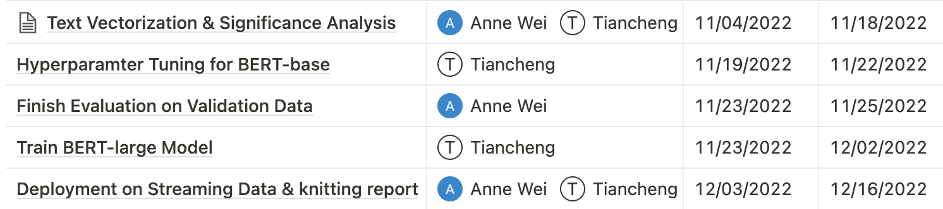
Future Plan
Improve the NLP model
Train the complex BERT network (e.g., BERT-large)
Train for more epochs with better-tuned hyper-parameters
Deploy the trained model to real-time data
Twitter API streaming on PySpark

